Slide 1

PRODUCT RECOMMENDATION BASED ON MERCHANT PROFILLING WITH DECISION TREE AND ITEM-TO-ITEM COLLABORATIVE FILTERING IN B2B

Slide 2



Marketplace di Indonesia
Publish Product
Mencari Produk
Merchant
Customer

Slide 3
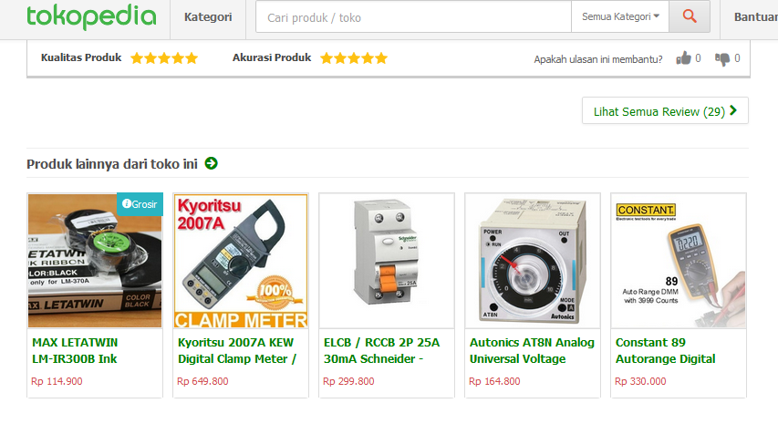
Currently Product Recommendation
Items are recommended by Tokopedia to Customer based on Merchant

Slide 4
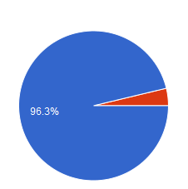
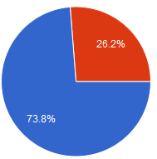

Problems in Product Recommendation
Relevant Recommendation?
Fraud ? Because of recommendation to wrong Merchant
80 Respondent
Customer likes Recommendation
Based on similar Item
Customer likes E-Commerce
That can handle Fraud
Notes:
Masalah jika merekomendasikan produk berdasarkan toko

Slide 5
Our Product Recommendation
Customer
Recommendation Algorithm :
Item-to-item collaborative Filtering
Social Media Interaction Framework : Decision Tree

Slide 6
Benefit
Relevant Recommendation (Proved in Amazon.com). Linden, Greg et al . Amazon.com Recommendation.
No Fraud.
Mergel, Ines. 2013. A Framework for Interpreting Media Social Interactions in Public Sector. Government Information Quarterly 30 (2013) 327–334

Slide 7
Recommendation Algorithm
Customer
Recommendation Algorithm :
Item-to-item collaborative Filtering
Social Media Interaction Framework : Decision Tree

Slide 8
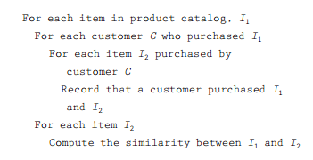
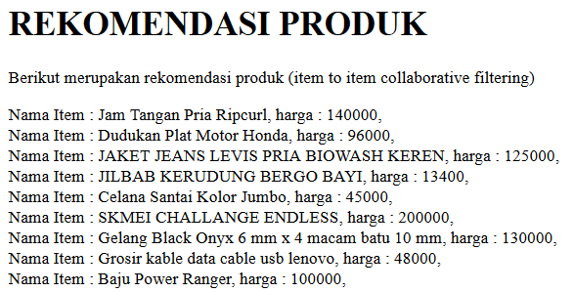
Recommendation Algorithm: Item-to-item Collaborative Filtering
Algorithm : O(n2m)
Result

Slide 9
Social Media Interaction
Customer
Recommendation Algorithm :
Item-to-item collaborative Filtering
Social Media Interaction Framework : Decision Tree

Slide 10
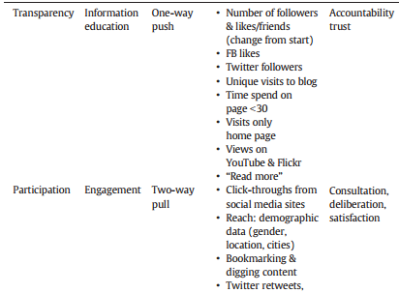
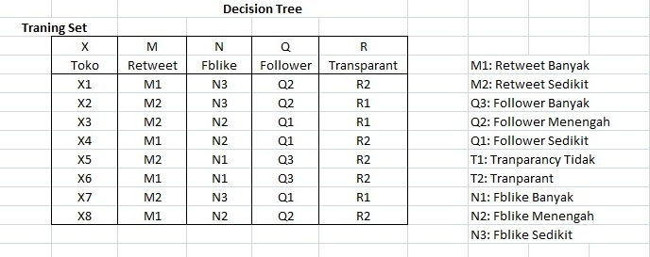
Social Media Recommendation Framework: Decision Tree
Social Media Interaction Framework (Mergel, Inez. 2013)
Training Set (8 data sample in dataset)

Slide 11
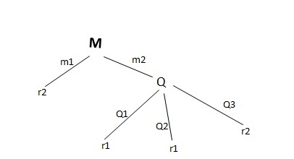
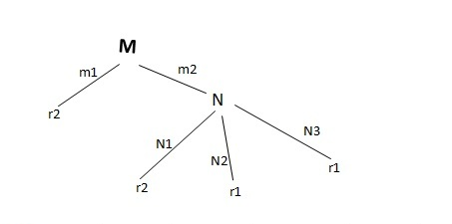
Social Media Recommendation Framework: Decision Tree(Cont’d)
Calculate “Gini Index” for each Training Set
Set Decision Tree
Final Decision Tree After Calculation

Slide 12
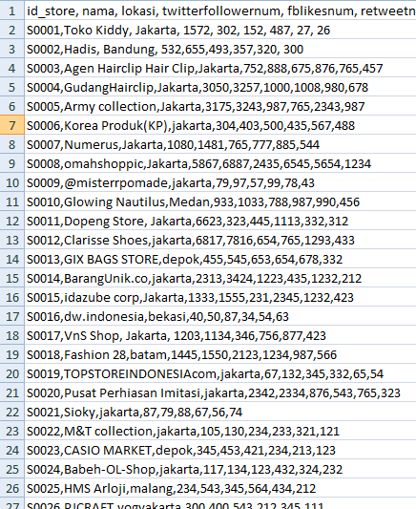
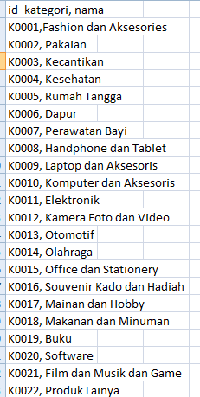
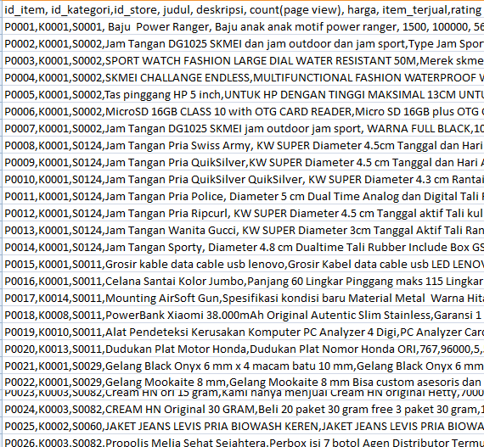
Implementation : Dataset
Scrapping from Tokopedia

Slide 13
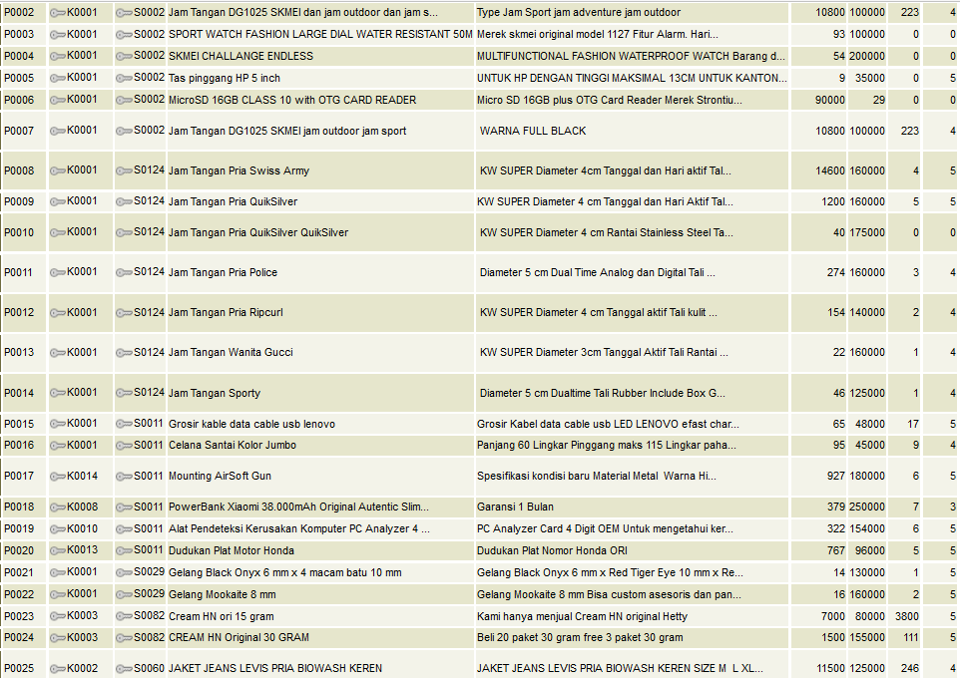
Implementation : Database
Database is generated by Pentaho Data Integration from Dataset

Slide 14
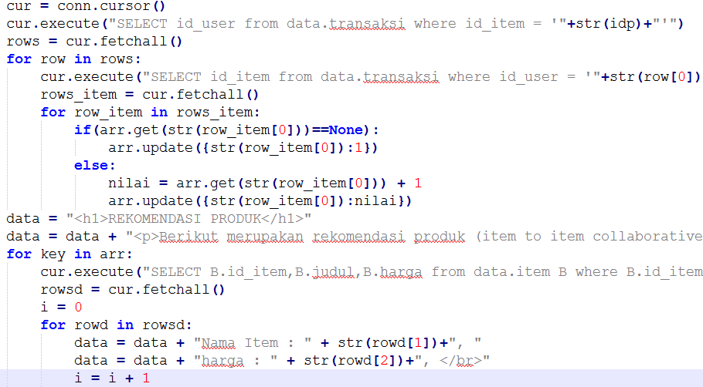
Implementation : Coding
Python + Flask Framework : O(n²)+ O(m²)

Slide 15
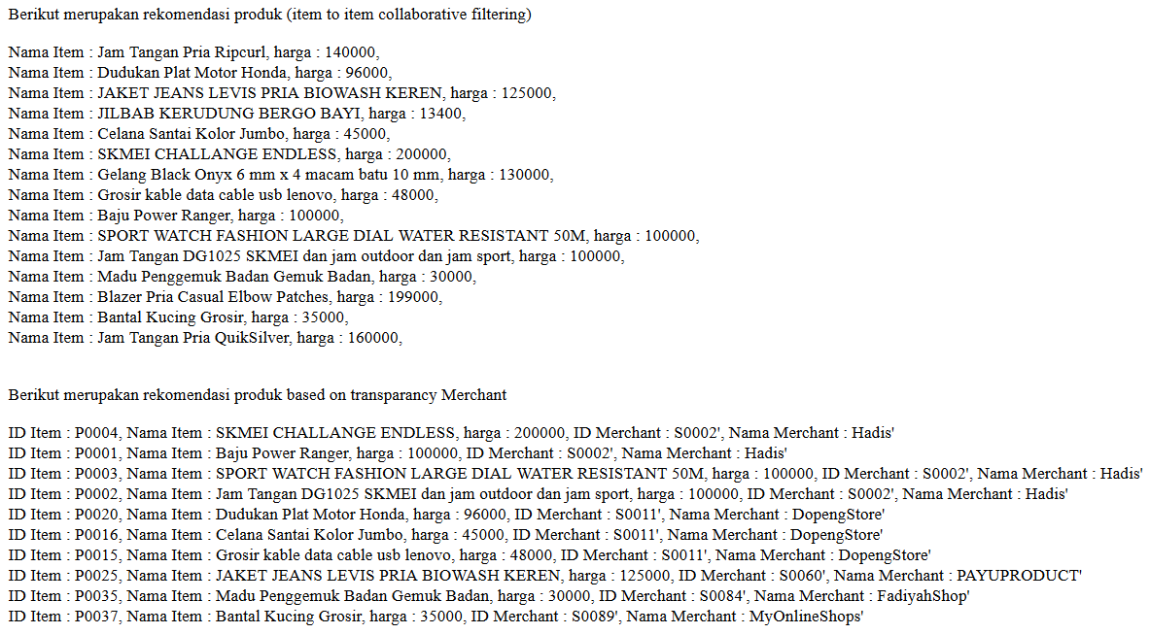
Result: Running on Web

Slide 16
PRODUCT RECOMMENDATION BASED ON MERCHANT PROFILLING WITH DECISION TREE AND ITEM-TO-ITEM COLLABORATIVE FILTERING IN B2B

